Slide 1

Recommender System
Foo Lee Yi

Slide 2
What Can Recommender System Do?
Helps users discover products or services they may interested
Predicts the future preference
Provides personalized suggestion
Filtering system
Used to predict liking / preference for a particular product or service

Slide 3
Type Of Recommender System
Content-based Filtering
Collaborative Filtering

Slide 4
Content-based Filtering
Suggest item based on a particular item
Work on item features or attributes
Predict the behavior of a user based on the item they react to

Slide 5

Benefits Of Content-based Filtering
ML model no need the information of the users
Only need to know the interest of the users -> easy to scale the model
Does not have cold start problem

Slide 6
Limitations Of Content-based Filtering
The quality of the recommendation is dependent on the hand-engineering features
The model unable to recommend users something outside their range of interest

Slide 7

Collaborative Filtering
Finding similar users to target user to make personalized recommendations
Do not require item metadata
Solely rely on past user-item interaction to render new recommendations
Solely depends on the historical preferences of a user and the interaction between a user and an item

Slide 8
How User Preferences Being Studied?
Explicitly
Rating or feedback given
Implicitly
Clicks, views, hovering time

Slide 9

Types Of Collaborative Filtering
Memory-based collaborative filtering ( Neighborhood-based filtering)
Model-based collaborative Filtering

Slide 10
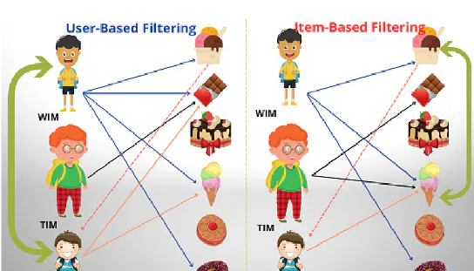
Memory-based Collaborative Filtering
Past interaction between a user and item are stored in user-items interaction matrix
The recommendations are made either in a user-based or item-based fashion

Slide 11
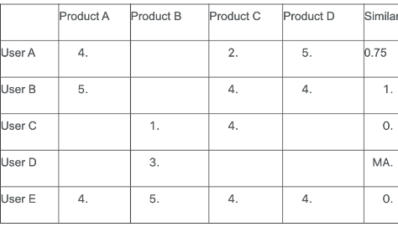
User-based Collaborative Filtering
Aims at finding similar users and recommendations are made to a user based on what a similar user has liked
The similarity between users is calculated using either Cosine Similarity or Pearson Correlation

Slide 12
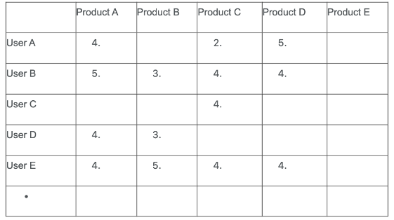
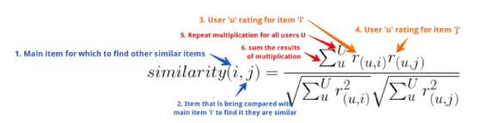
Item-based Collaborative Filtering
Help to avoid the dynamic preference problem posed by user-based filtering

Slide 13

Limitations Of Memory-based Collaborative Filtering
Do not scale easily
When using huge datasets, the memory-based collaborative filtering technique is close to impractical
Has the cold-start problem

Slide 14
Model-based Collaborative Filtering
The user-item interaction matrix is very sparse
Reduce or compress the user-items interaction matrix into 2 matrices using user-factor matrix by using Matrix Factorization Techniques for recommender system
Latent factor -> captures the similarity between users and items
Let the model discover the hidden representations of user interests and item attributes

Slide 15
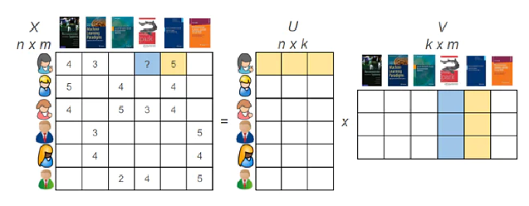

Slide 16

Advantages
Easy to scale and can be used to work on super large datasets
Overfitting can be avoided
The prediction speed is much faster than memory-based model because only query the model not the whole dataset

Slide 17

Disadvantages
The quality of the predictions is solely dependent on the quality of the model built
Not very intuitive especially if using deep learning models

Slide 18

Coding Time !!!

